Slide 1
Pizza Delivery System (PDS)
Release 2

Slide 2
Team B: s361-02b
Jedd Haberstro (Configuration/QA Coordinator)
Obaseki Idemudia (Development Coordinator)
Gregg Miller (Team Coordinator)
Johanna Calderon (Requirements Coordinator)
Jenny Zhen (Test Coordinator)
Richard Sperrazza (Development Coordinator)

Slide 3
Overview
Pizza Delivery System
Take orders placed over the phone
Send the order to the kitchen
Fill ovens with food to cook
Send the finalized orders out for delivery
Notes:
Jo

Slide 4
Features
Creates Customers
Creates Orders
View order progress
Modify Order
Cancel Order
Configure the Menu
Configure chefs, ovens, and drivers
Database of customers and orders
View Reports
Saved preferences for customers
Based on last order placed
Notes:
Jo

Slide 5
Missing Features
Official Features
Manager UI incomplete
Stage times (preparation, cooking, delivery, etc.)
Error was found extremely late
Unofficial Features
Delivery system is not optimized for multiple orders in a delivery
Orders database is not saved continually
Unsaved work is lost in a crash
Saving an order in progress corrupts database
Notes:
Rich

Slide 6
System Requirements
A computer with an Operating System installed.
E.g. Windows 7.
Java run-time environment SE 1.6
Configure menu.txt and config.txt as desired
Run pds.jar
(double click or by command line)
Notes:
Rich

Slide 7
User's Profile
Basic knowledge of computer is required.
Phone Operator – Place order, modify or cancel order, forwards order to kitchen.
Order Entry Display
View Order Tracking Display.
Manager – Change the menu, set ovens and employees at the start of the day, and view reports of completed orders.
Manager Reports Display
Editable text files for menu and system settings
Notes:
Jenny

Slide 8
Testing Approach
At first, each part was created and tested individually
Then individual parts were tested as a whole by the developer team
Team A provided external testing
Freshman Seminar found the last of the errors
Notes:
Jenny

Slide 9
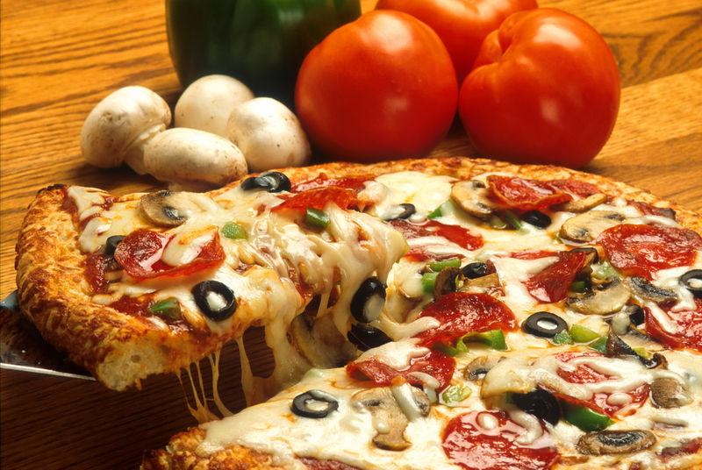
Demonstration
Notes:
OB GREDD JEGG

Slide 10
Q & A
Notes:
Team BBBBBB

